Slide 1


Slide 2










Visit York Tourism Awards

Slide 3
Visit York Tourism Awards
Entry Workshop – 9 July 2024
Welcome & Introduction
Polly Bennett

Slide 4
Aims of today
Top tips
Common pitfalls
Practical advice on completing the application form
Confidence
Chance to ask questions

Slide 5
The Judging Process
Complete the application form
Judging panels mark and discuss applications
Shortlists announced
Finalists mystery shopped or interviewed
Judges meet to decide winners
Winners announced at the awards ceremony

Slide 6
Feedback from Winners
“One of the most useful benefits of applying for a Visit York Award is that you get a full Mystery Shop visit and report. These normally cost hundreds of pounds, and are a great way to highlight any areas for improvement - which can in turn give you a stronger application in following years!”
“A Visit York Award gives tourists added confidence in booking, and is a real badge of honour to display on marketing materials!”
“Going forward to the VisitEngland Awards was a great opportunity to network and rub shoulders with some of the tourism greats across the country. It’s led to partnerships with some big organisations and also generated a lot of press - both nationally and locally. With the summer holidays coming up, it’s great timing for an extra push to fill the tours!”
-The Wizard Walk of York

Slide 7
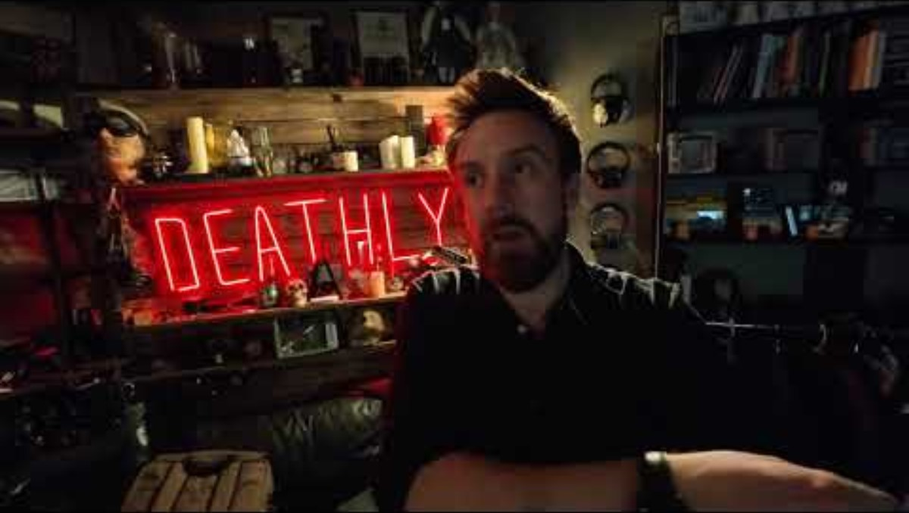
Feedback from Winners

Slide 8
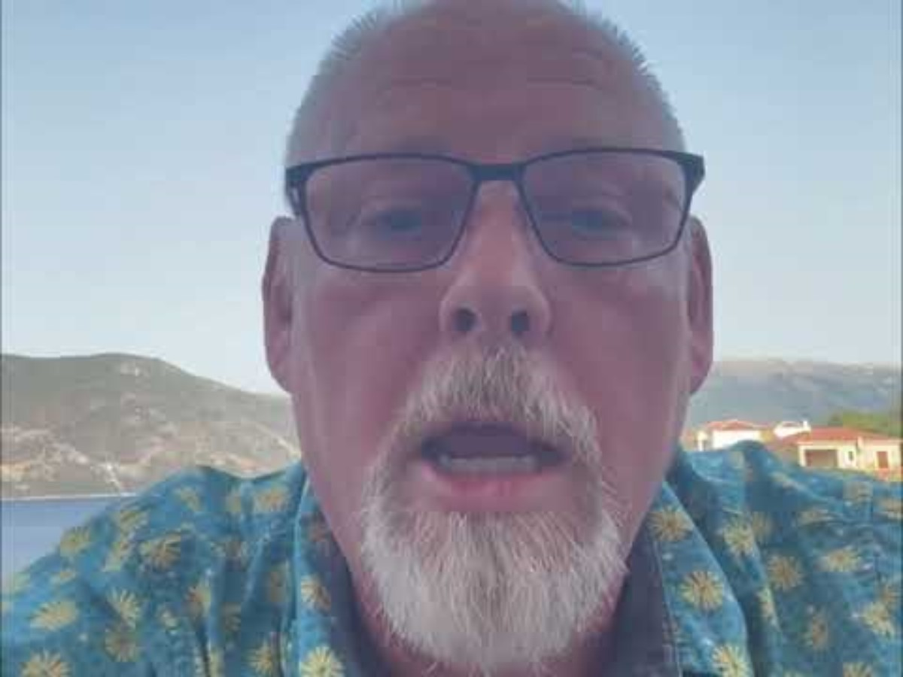
Feedback from Winners

Slide 9
The Application Form
Brendan Paddison
Ann Gurnell

Slide 10
The Application Form
Introductory questions (30% in total)
Answer the questions carefully
Think about what you’ll be saying in the Q1-4 answers
Make everything connected and supportive
Avoid contradictions

Slide 11
The Application Form
Q1. Your top qualities (500 words 20%)
What makes you special?
How do you go above and beyond in your sector?
Think about all aspects of the business
  How it runs, the people, the guests/customers, your partners,
  Your market(s): York, the regional, UK, international

Slide 12
The Application Form
Q2. Your recent improvements (500 words 20%)
Tell us what you’ve done and WHY
For example:
To sort out a problem
To attract a new type of customer
To increase loyalty and repeat visits
To increase customer spend and/or margin
Does it tie in with the future plans in Q4 below?

Slide 13
The Application Form
Q3. Your results (300 words 15%)
Show you understand your whole business:
It’s challenges and opportunities
How you evaluate return on investment, marketing, strategy and planning
Provide evidence - clear facts and figures

Slide 14
The Application Form
Q4. Your future plans (300 words 15%)
Remember to tie it in to all the answers you’ve given so far
Be precise: what and why
Use facts and figures

Slide 15
What else do Judges look for
Polly Bennett

Slide 16
What else do Judges look for
Reviews – are you responding / engaging?
Social media is a way of telling your story:
  Quality of content
  Consistency
  Authentic engagement
  If you have a head office how is this content localised?

Slide 17
What else do Judges look for
Who do you partner & collaborate with?
What challenges have you experienced and how did you overcome?
How important is your team / volunteers:
  Why do they love working at your place?
  What learning & development opportunities are there – case study.
  How flexible are you as an employer?

Slide 18
What else do Judges look for
How accessible is your business from a physical and sensory perspective?
How sustainable is your business?
  Don’t try to green wash but be clear on intent & what you are doing.
  What are your plans for the future?

Slide 19
Top Tips
Choose the right category(s) for your business and where you can shine best
Check your eligibility
Read the questions carefully
Answer the questions
Make it easy to read and understand

Slide 20
Top Tips
Use simple, succinct language - avoid jargon or exaggerated language
Avoid cutting and pasting
Provide supporting evidence
Check any links you include actually work
Proofread, proofread, proofread.

Slide 21
Any Questions?
Application closing date:
5pm, Friday 6th September 2024

