Slide 1

Managing users and permissions

Slide 2
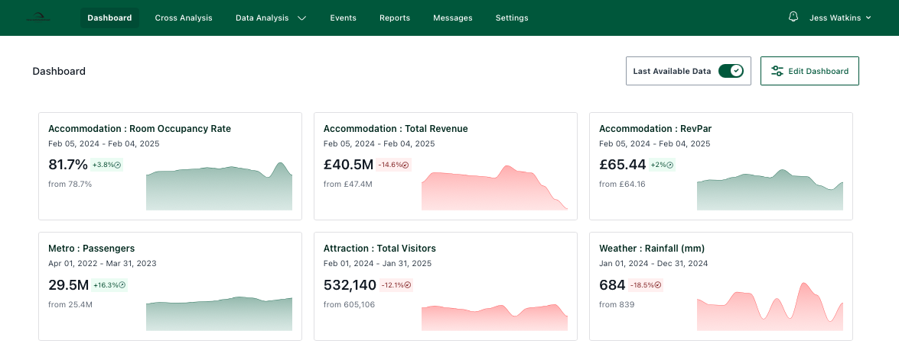
This guide shows you how to add new Users to your organization, add new Provider Users, remove User access, and edit permissions.
To add a new User within your organization you must have Admin permissions. If you are unsure of your permission level, select Settings from the main menu at the top of your screen. (If you cannot see Settings, you have Viewer level permissions and cannot edit Users. Please contact your organisation Admin or the T-Stats team.)
To add a new Provider User (a user linked to a specific business) please jump to page 4. This is extremely important to maintain the confidentiality of all business data in the system.

Slide 3
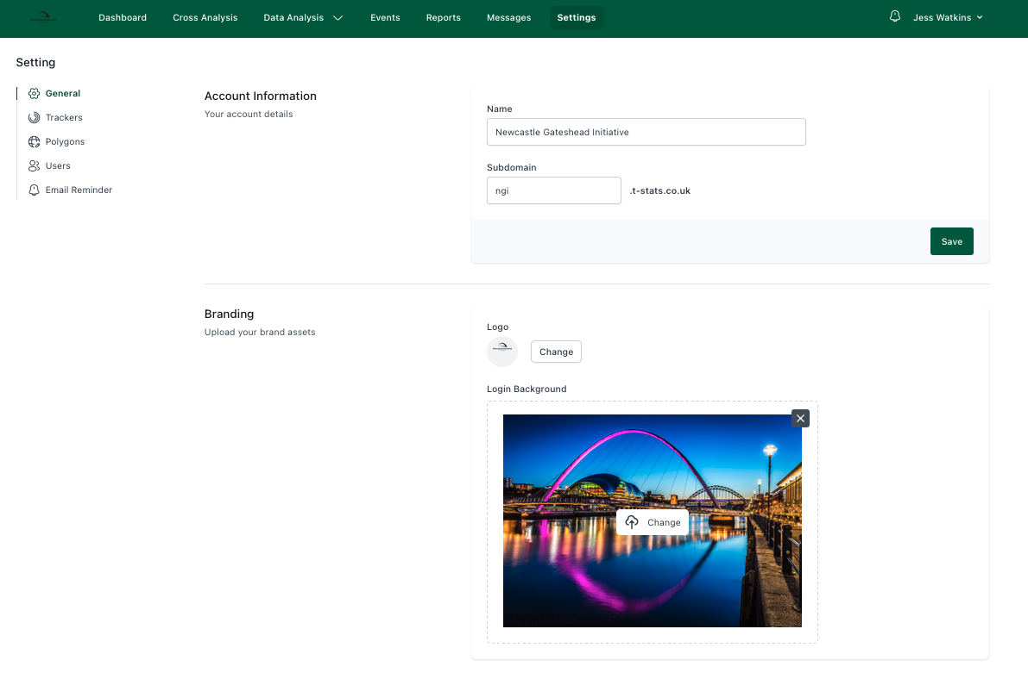
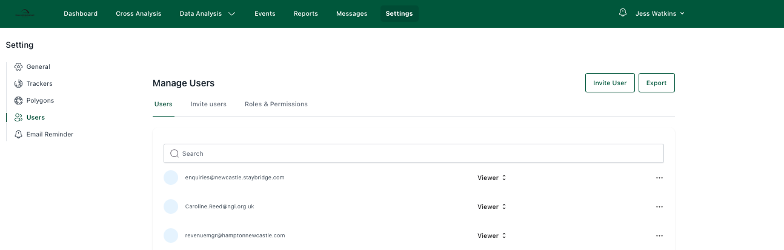
Once in Settings, if you have Admin level permissions you will see ‘Users’ available in the Settings menu.
Click on Users.
You will now see this page. If you scroll down, you will see a list of all your existing users and their current permission
levels.
On this page you can add new users, edit permissions and remove access to your existing users.

Slide 4
When inviting a new organisation level user, select the appropriate permissions level for them. User permissions are explained below.
To remove access or edit user permissions, click on the three dots to the far right of the user’s name.
Admin – User with access to create and view trackers, add other users, input data, edit organisation details and produce reports. Automatic access to view every tracker in the system.
Member – User with access to view all trackers, input data and create reports. Cannot add or edit users or edit organisation details. Select tracker access.
Viewer – Partner or client user who can view analysis for selected trackers/providers. Select tracker access.
NOTE: All Provider Admins appear on this page as Viewer. This is because they only have Viewer level permissions across the entire system.

Slide 5
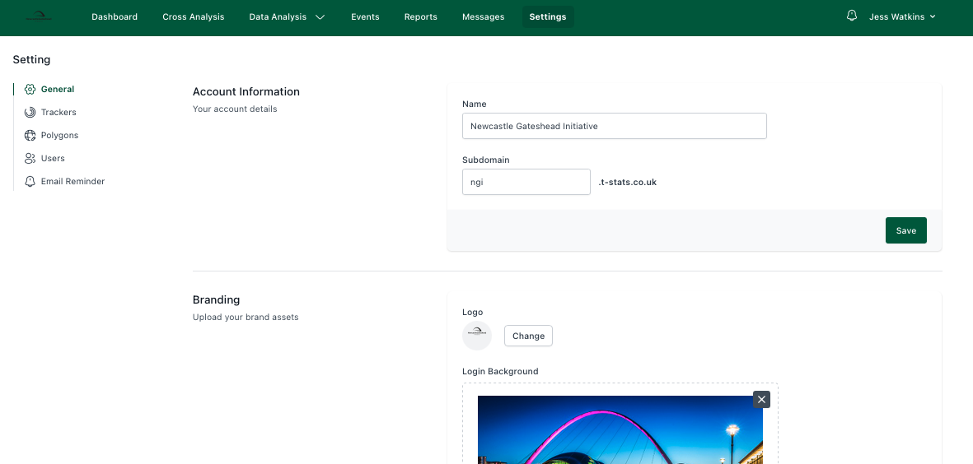
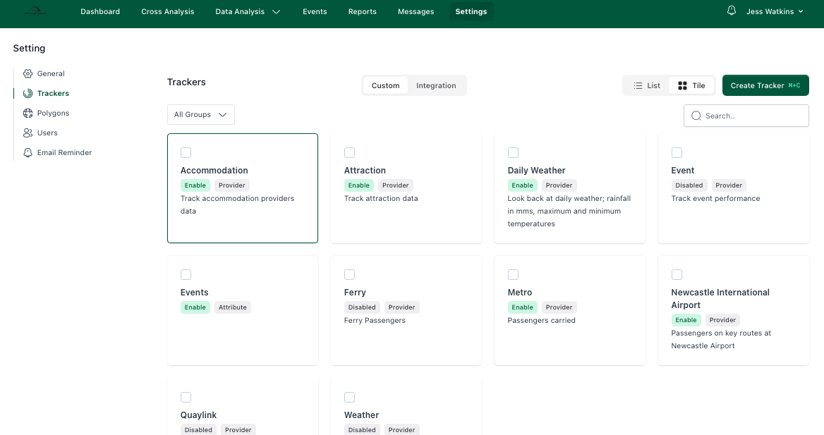
When adding a User to a Provider, the invite must be sent from the Provider account area. To access the Provider account details head to the Tracker Settings.
Select the appropriate tracker…
Usually, Accommodation or Attraction

Slide 6
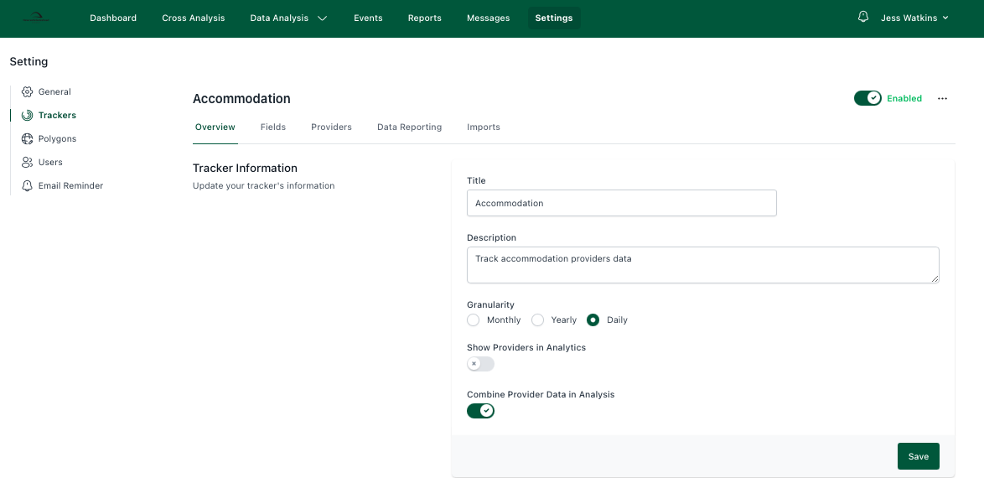
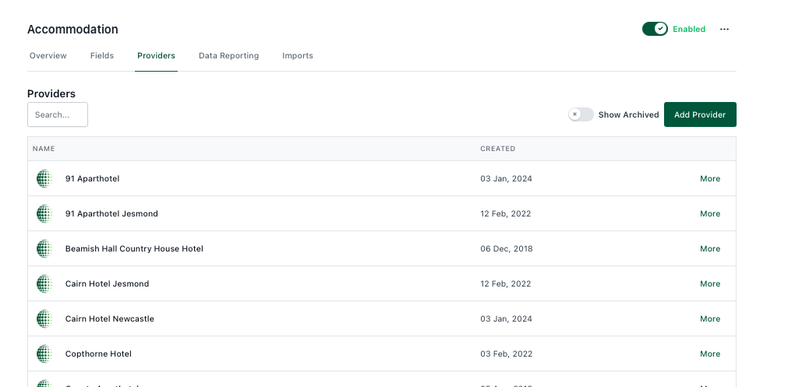
Click on Providers
Select the Provider to add the User to, or click Add Provider if they’re a newly engaged business.

Slide 7
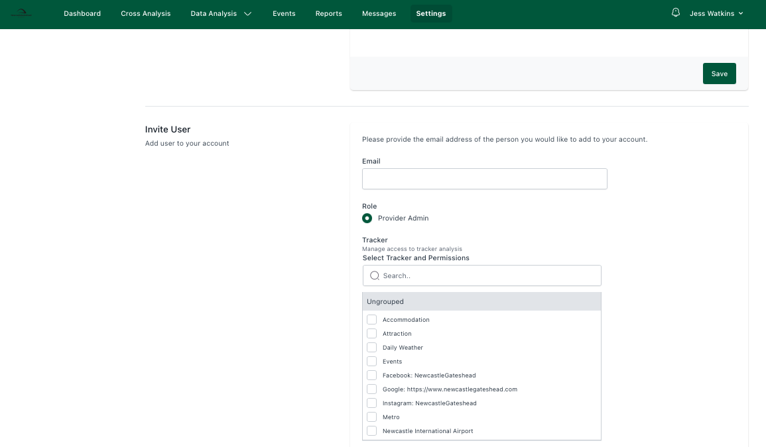
On the Provider details page, scroll down until you find ‘Invite User’.
Type the User’s email address and select the other trackers you would like them to access. If you have trackers in your system that are only to be viewed by those within your organization, leave these unchecked.
If this is the first User associated to this Provider account, they will be Admin level, by default. Subsequent users can be added as Members or Viewers.
Admins within this part of the system can edit and view data relating to the Provider they are Admin for. In the main User list for your T-Stats system this User will still show as Viewer, because they do not have access to all the data in the system.
Adding Users this way ensures all business data remains confidential to the Admins, Members and Viewers of that business only.
If the User is new to T-Stats they will receive an email invite. If they are an existing user, they will be automatically assigned this level of permission.

